Slide 1
FreeRTOS Monitoring on IoT devices
Daniel Guarecuco
Maja Markusson
Juan Paños

Slide 2
Contents
Topic research
What is IoT?
Clustering + Protocols
Attacks + Safety implications
Monitoring
FreeRTOS
Keylogger
Use cases proposal
Demo
Conclusions

Slide 3

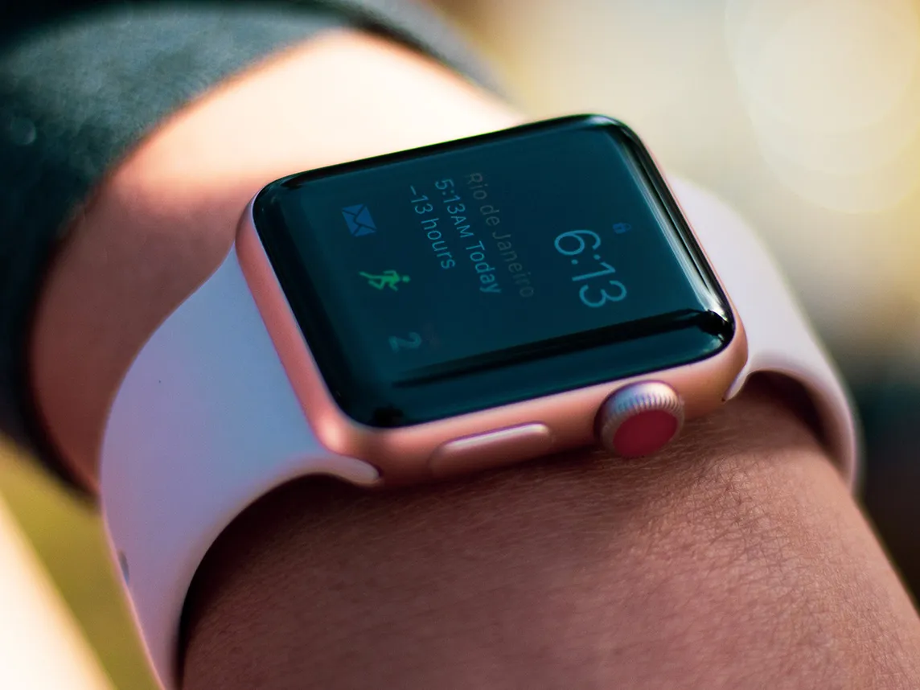


What is IoT?
“The network of devices that contain the hardware, software, firmware, and actuators which allow the devices to connect, interact, and freely exchange data and information.”
National Institute of Standards and Technology
Notes:
Source citation: https://csrc.nist.gov/glossary/term/internet_of_things_IoT
Source image: https://media-assets.vanityfair.it/photos/6156bef1f87918b361109fe1/4:3/w_1144,h_858,c_limit/smartwatch-p.jpg
https://researchleap.com/wp-content/uploads/2021/09/Usine-du-futur_0-scaled.jpg
https://www.tradeinn.com/techinn/no/xiaomi-smart-kaffetrakter-seven-me-cm162/138242138/p
https://bernardmarr.com/img/10%20Amazing%20Examples%20of%20Robotic%20Process%20Automation%20in%20Practice.png

Slide 4

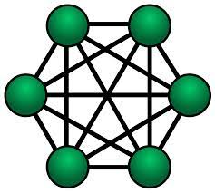
Clustering IoT devices
Why do we cluster?
Mesh Topology
Full or part
All devices connected
Inconsistent routing
Redundancy
Star Topology
Master node
Independent connections
Less fault tolerant

Slide 5
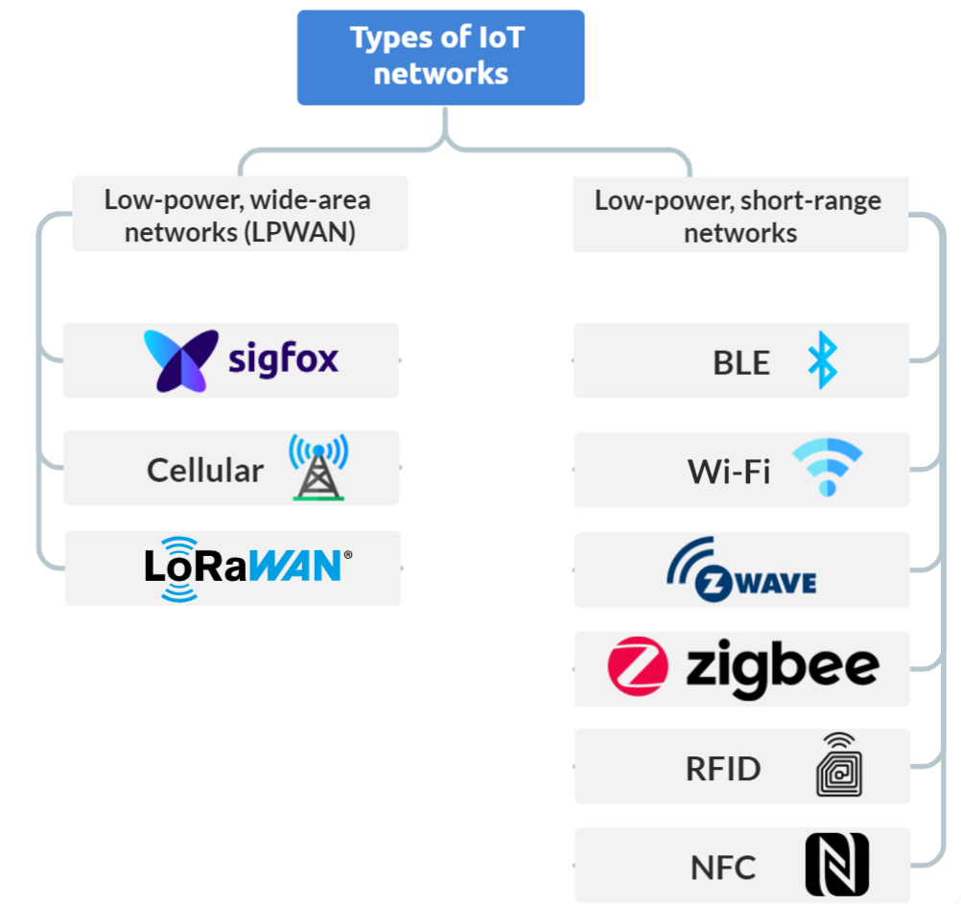
Communication protocols
Protocols vary:
Wired vs Wireless
Range
Security
Power consumption
Topology
Data rate
Selection depends on the use case!
Notes:
Source images: https://www.techtarget.com/iotagenda/tip/Top-12-most-commonly-used-IoT-protocols-and-standards

Slide 6
Attacks on IoT devices
Which attacks are relevant when speaking of IoT clusters?
NODE TAMPERING
HARDWARE ATTACKS
Subversion, removal or addition of nodes to the cluster
Destroying or tampering with the device hardware to gain access or information
EAVESDROPPING
Monitoring information in and out of node to snap up private information
ROUTING ATTACKS
Tampering with routing algorithms to clog or deprive specific routers of network traffic
MitM
Adding an additional node that information is rerouted through but not detectable in the cluster
DoS
Exhausting dedicated resources to make the device neglect legitimate requests

Slide 7
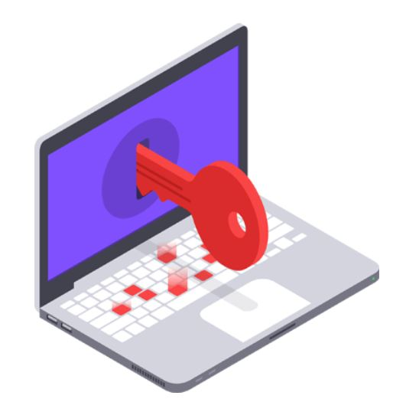
Keylogger
Malicious software that collects system events (key pressed) to collect data (user input) which is then filtered to obtain critical information such as passwords
Can it be used as an inspiration?
Notes:
Source image: https://www.avast.com/it-it/c-keylogger

Slide 8
Intelligent Monitoring
Anomaly detection: Unexpected, anomalous data can indicate critical incidents! (Attacks, System failures…)
User patterns: Crucial information can be obtained
System specific: Extraction of intelligent information depends on each system and requires a thorough analysis of the collected data

Slide 9

FreeRTOS
Open source real time OS
OS components
A very simple OS which require a lot of development to obtain the desired functionality
Notes:
Image source: https://commons.m.wikimedia.org/wiki/File:FreeRTOS_logo_2005.svg

Slide 10
Monitoring the FreeRTOS
Focused on collecting OS parameters and events:
Socket activity, Tasks running, System events
Application independent, but to extract intelligent information the application needs to be considered.

Slide 11
Challenges with monitoring
IoT applications are often developed in close relation to the technologies/protocols used, which makes intelligent monitoring highly application dependent
Monitoring increases the use of resources, which often is limited in embedded applications

Slide 12

Oil Platforms
Wireless Sensor Network
Part-mesh topology
ZigBee
Safety aspect
Possible attacks
Monitoring
Notes:
Image source: https://www.kindpng.com/imgv/ihxxmwT_oil-platform-png-transparent-png/

Slide 13

Security Cameras
Fixed position sensors
Star topology
Wifi
Safety aspect
Possible attacks
Monitoring
Notes:
Image source: http://mobileimages.lowes.com/productimages/24e275a9-4854-46df-bdb5-fb107f7ff801/09593456.jpg

Slide 14

Health Monitors
Elderly health monitoring
Star topology
WiFi
Privacy
Possible attacks
Monitoring
Notes:
Image source: https://physicsworld.com/wp-content/uploads/2019/10/Health-monitor-cropped.jpg

Slide 15
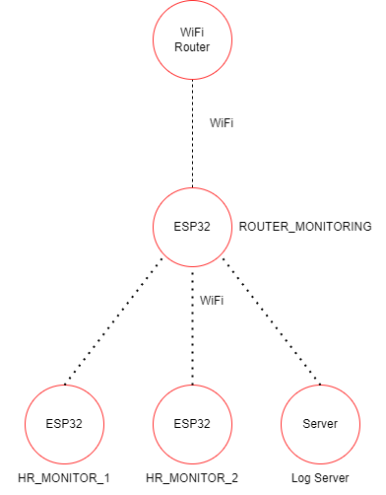
Demo
ESP32
Dual core
Bluetooth and WiFi support
ESP-IDF build tool
Implementing health monitoring
Using the ESP32 board
Added FreeRTOS+esp-lwip support
Monitoring sockets + Network activity + DoS attacks.

Slide 16
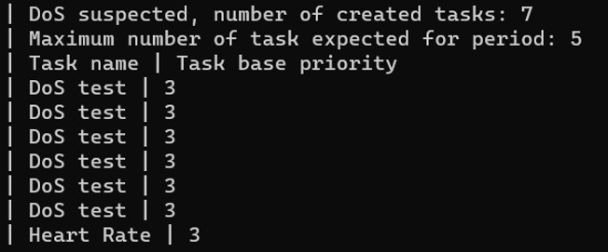
Monitoring demo
Running tasks
The scheduling of an embedded device should be as deterministic as possible
An excessive amount of tasks could indicate that an DoS attack has been launched
Too many tasks == DoS Attack!

Slide 17
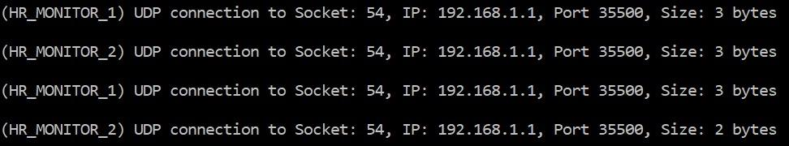
Monitoring demo
UDP Packets
Sockets are monitored:
If packets are being sent to unexpected ip/Have unexpected size?
Information theft! DoS Attempt!

Slide 18
Monitoring demo
Connected Nodes + MAC addresses
Number of nodes should be known in this use case (Application level)
Too many nodes can imply false nodes!
Too few nodes can imply jamming/DoS attacks on nodes…
Mac not whitelisted could mean malicious node!

Slide 19
Conclusion
Attacks detected by monitoring the OS is limited
Choice of protocol and topology changes vulnerabilities and attack surface
Intelligent monitoring is connected to knowledge of the system

